Slide 1
Logistic Regression
Group 20
Section A
Mounika Reddy
Venkata Subba Reddy Karnati

Slide 2
Simmons Catalogue
Simmons’ catalogs are expensive and Simmons would like to send them to only those customers who have the highest probability of making a $200 purchase using the discount coupon included in the catalog.
Simmons’ management thinks that annual spending at Simmons Stores and whether customer has a Simmons credit card are two variables that might be helpful in predicting whether a customer who receives the catalog will use the coupon to make a $200 purchase.
Simmons conducted a study by sending out 100 catalogs, 50 to customers who have a Simmons credit card and 50 to customers who do not have the card. At the end of the test period, Simmons noted for each of the 100 customers:
1) the amount the customer spent last year at Simmons,
2) whether the customer had a Simmons credit card, and
3) whether the customer made a $200 purchase.
To interpret the results for the above problem statement will be building the model using Logistic regression technique.

Slide 3
Logistic Regression
In many ways logistic regression is like ordinary regression. It requires a dependent variable, y, and one or more independent variables.
Logistic regression can be used to model situations in which the dependent variable, y, may only assume two discrete values, such as 0 and 1.
The ordinary multiple regression model is not applicable.
In the Dataset considering Purchase as target variable and 0 as ‘Not purchased’ and 1 as ‘Purchased’.

Slide 4
Logistic Regression Equation
The relationship between E(y) and x₁, x₂, . . . , x_{p} is better described by the following nonlinear equation.

Slide 5
Interpretation of E(y) as a Probability in Logistic Regression
If the two values of y are coded as 0 or 1, the value of E(y) provides the probability that y = 1 given a particular set of values for x₁, x₂, . . . , x_{p}.

Slide 6
Estimated Logistic Regression Equation
A simple random sample is used to compute sample statistics b₀, b₁, b₂, . . . , b_{p} that are used as the point estimators of the parameters β₀, β₁, β₂, . . . , β_{p}.

Slide 7
Simmons Test Data (partial)
x₁
x₂
y
Customer | Annual Spending($1000) | Simmons Credit Card | $200 Purchase
1 | 2.291 | 1 | 0
2 | 3.215 | 1 | 0
3 | 2.135 | 1 | 0
4 | 3.924 | 0 | 0
5 | 2.528 | 1 | 0
6 | 2.473 | 0 | 1
7 | 2.384 | 0 | 0
8 | 7.076 | 0 | 0
9 | 1.182 | 1 | 1
10 | 3.345 | 0 | 0

Slide 8
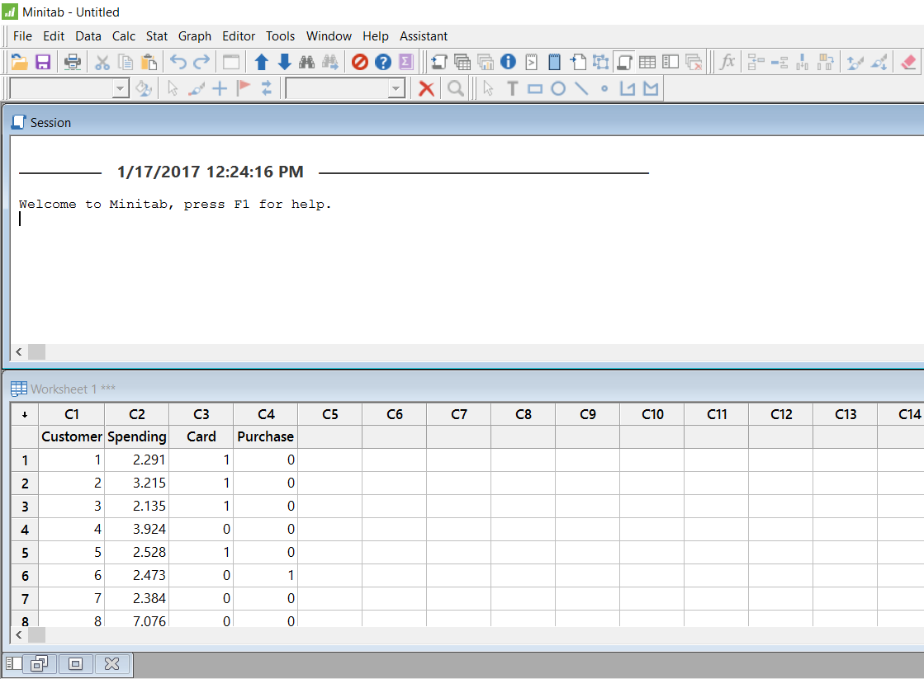
Simmons Logistic Regression Table (using Minitab)

Slide 9
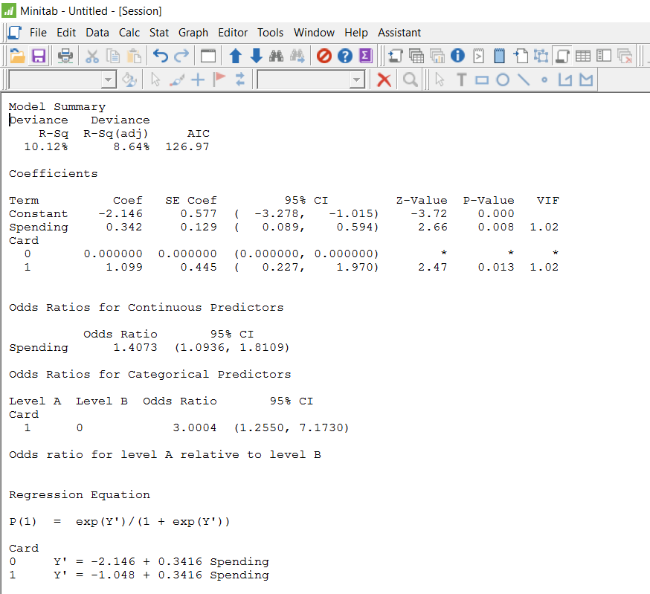
CONTINUED..

Slide 10
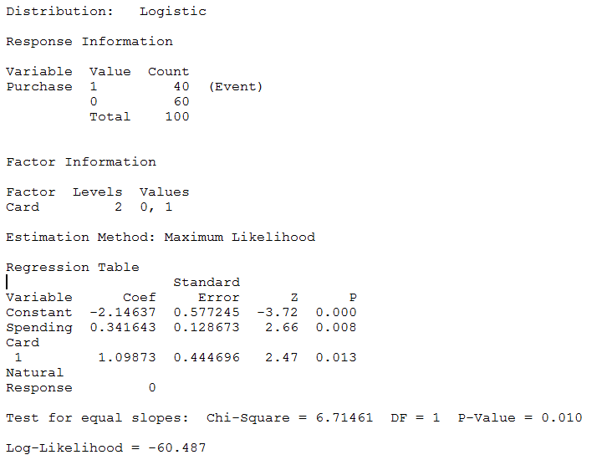
CONTINUED..

Slide 11
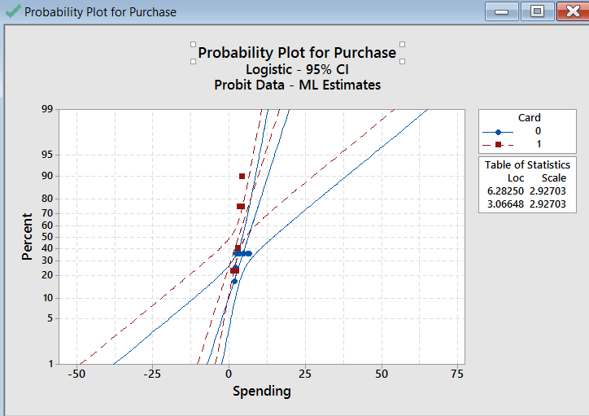
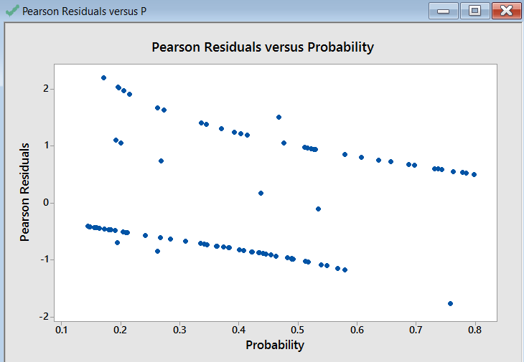
Graphs

Slide 12
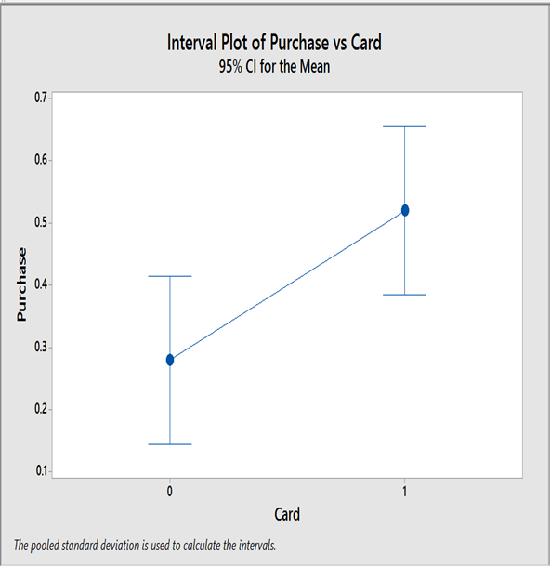
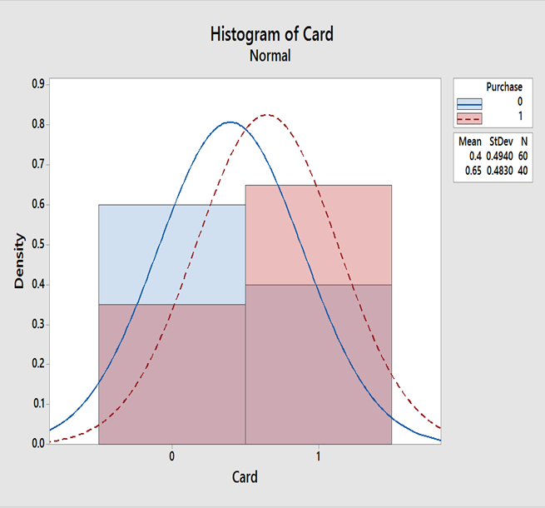
Continued..

Slide 13
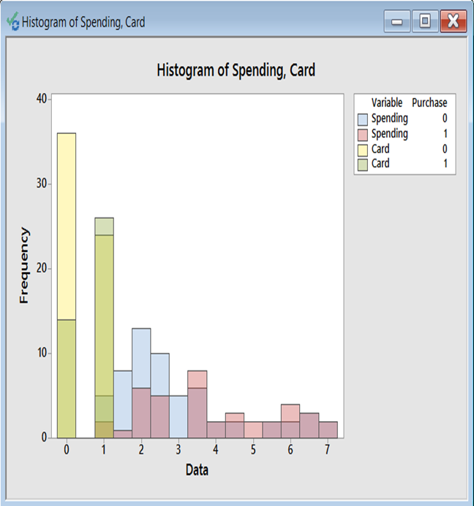
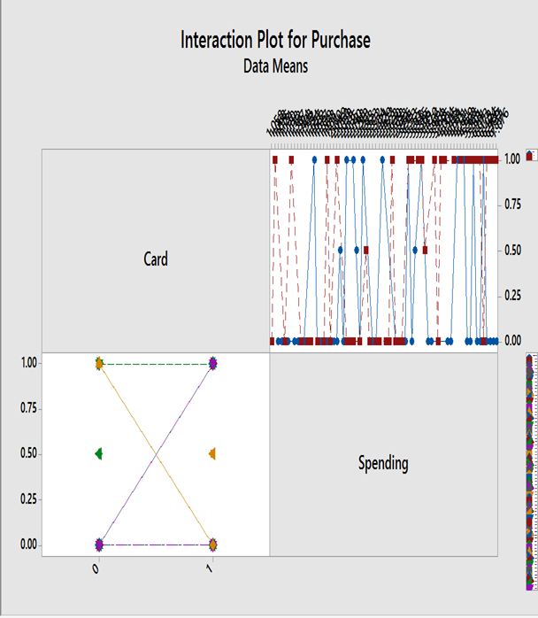

Slide 14
Simmons Estimated Logistic Regression Equation

Slide 15
Using the Estimated Logistic Regression Equation
For customers that spend $2000 annually and do not have a Simmons credit card:
For customers that spend $2000 annually and do have a Simmons credit card:
Thus, for this group of customers, the probability of using the coupon is approximately 0.41.It appears that the probability of using the coupon is much higher for customers with a Simmons credit card.Before reaching any conclusions, however we need to assess the statistical significant of our model.

Slide 16
Testing for Significance
Hypotheses
H₀: β₁ = β₂ = 0
H_{a}: One or both of the parameters
is not equal to zero.
Test Statistics
z = b_{i}/s_{bi}
Rejection Rule
Reject H₀ if p-value < α

Slide 17
Testing for Significance
Conclusions
For independent variable x₁:
z = 2.66 and the p-value = .008.
Hence, β₁ = 0. In other words,
x₁ is statistically significant
For independent variable x₂:
z = 2.47 and the p-value = .013.
Hence, β₂ = 0. In other words,
x₂ is also statistically significant

Slide 18
With logistic regression is difficult to interpret the relation-
ship between the variables because the equation is not linear so we use the concept called the odds ratio.
The odds in favor of an event occurring is defined as the
probability the event will occur divided by the probability the event will not occur.
Odds in Favor of an Event Occurring
Odds Ratio

Slide 19
Comparing Odds
Suppose we want to compare the odds of making a $200 purchase for customers who spend $2000 annually and have a Simmons credit card to the odds of making a $200 purchase for customers who spend $2000 annually and do not have a Simmons credit card.
Thus, we can conclude that the estimated odds in favor of using the coupon for the customers who spent $2000 last year and have Simmons credit card are 3 times greater than the estimated odds in favor of using the coupon for customers who spent $2000 last year and do not have the card.

Slide 20
Estimated Probabilities
Annual Spending
Credit
Card
Yes
No
$1000 $2000 $3000 $4000 $5000 $6000 $7000
0.3305 0.4099 0.4943 0.5790 0.6593 0.7314 0.7931
0.1413 0.1880 0.2457 0.3143 0.3921 0.4758 0.5609
Computed
earlier
The above dig shows estimated probabilities for values of annual spending ranging from $1000 to $7000 for both customers who have a Simmons credit card and customers who do not have the card.if Simmons needs to target customers for new promotion
Simmons Promotion Strategy would be:
Customers who have a Simmons credit card : send the catalog to every customer who spent $2000 or more last year.
Customers who do not have a Simmons credit card : send the catalog to every customer who spent $6000 or more last year.
Looking at the estimated probabilities further, we can see that probability of using the coupon for customers who do not have a Simmons credit card but spend $5000 annually is 0.3922.Thus,the Simmons may want to Consider revising this strategy by including those customers who do not have the card, as long as they spent $5000 or more last year.

Slide 21
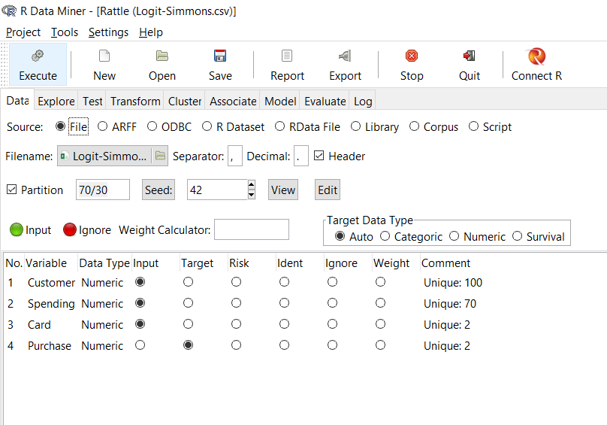
Using Rattle –Logistic Regression
The Dataset has 100 observations and target variable is Purchase and dataset is further divided into 70:30 70(train data) and 30(Test Data)

Slide 22
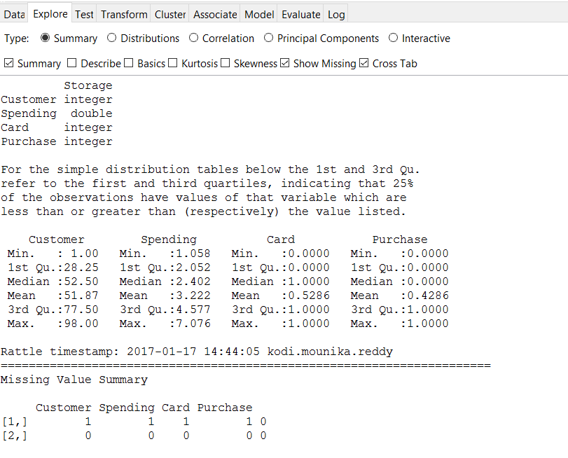
Data Exploration Analysis
The above screenshot shows data summary and Missing value summary we could see there is no Missing value found in the dataset.

Slide 23
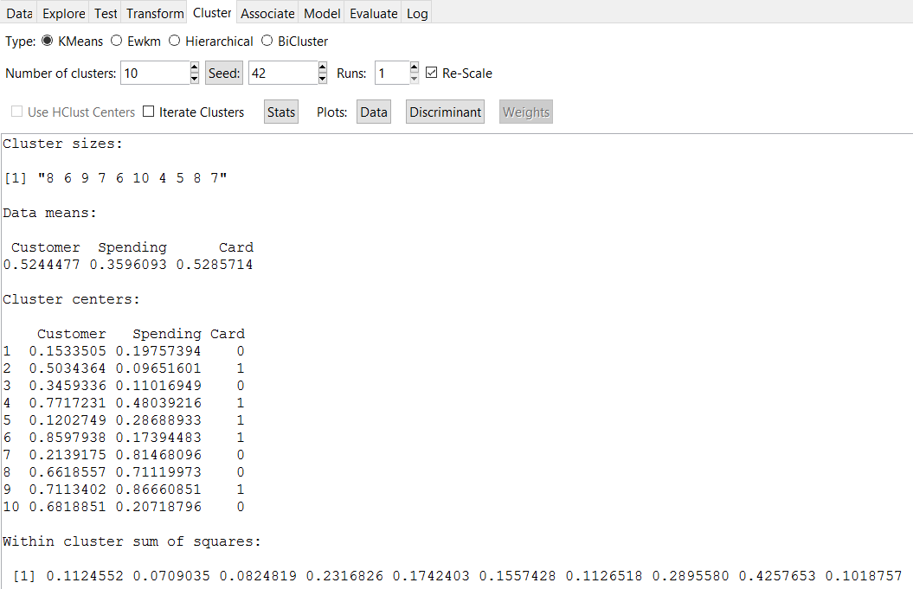
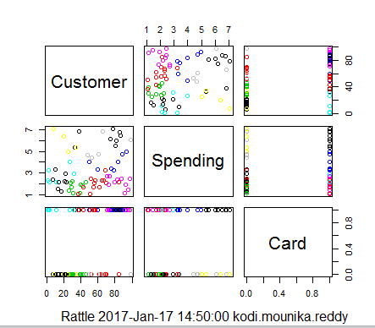
Cluster Analysis

Slide 24
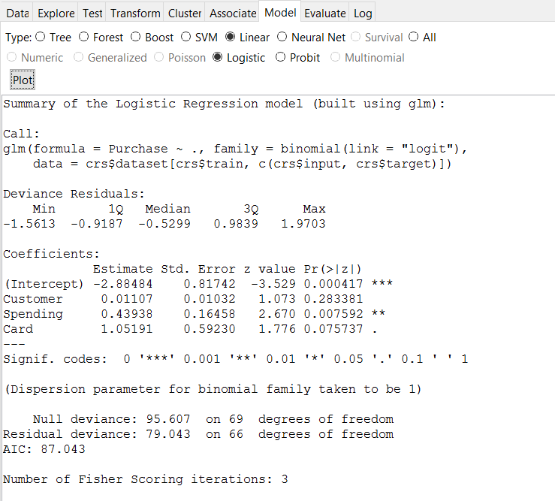
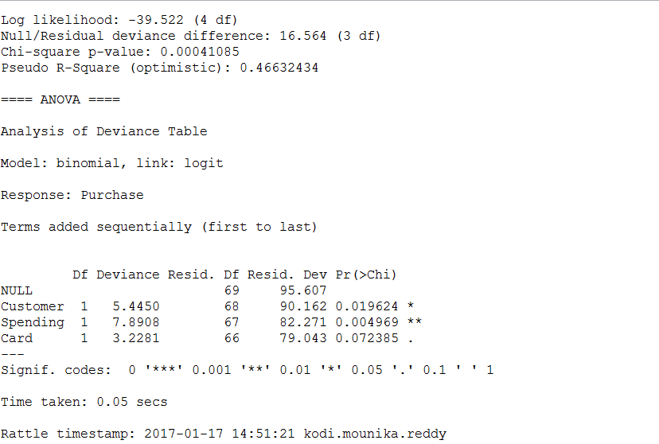
Building the Model

Slide 25
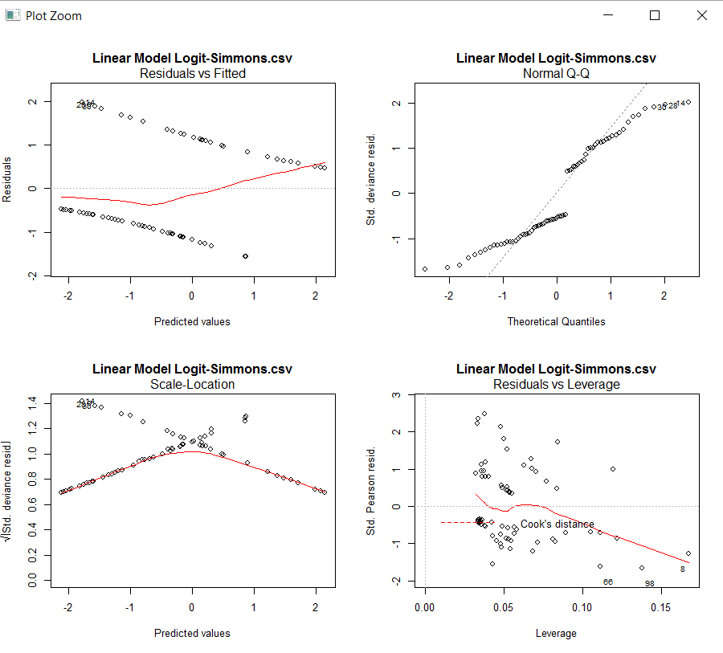
Plot for the Model

Slide 26
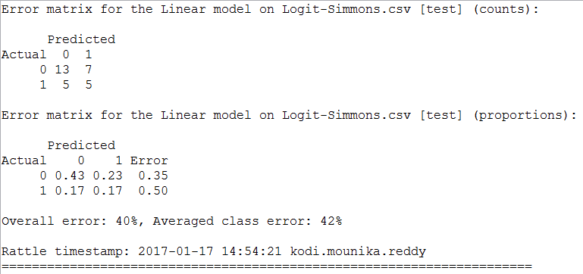
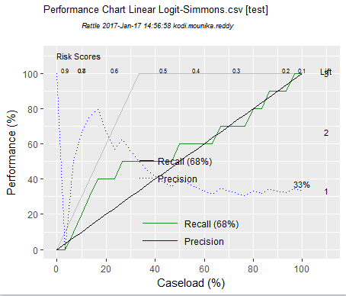
Error Matrix & Risk Chart

Slide 27
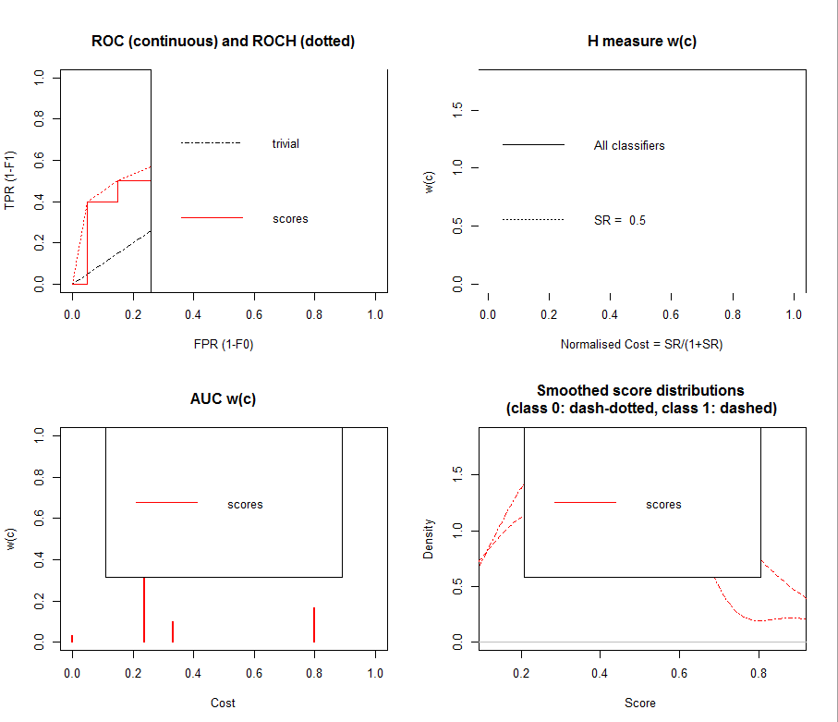
Performance measures

Slide 28
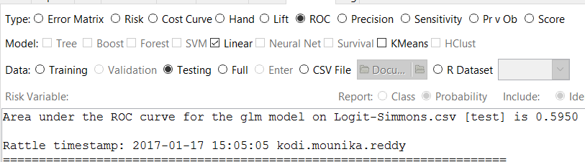
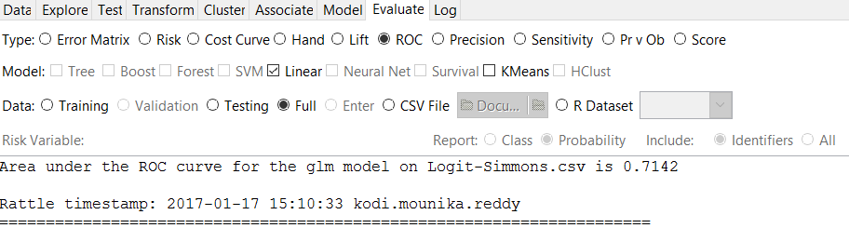
Roc Measures with test and full data
Roc with Test data we got 59.5% and whereas with full dataset we got 71.4%

Slide 29
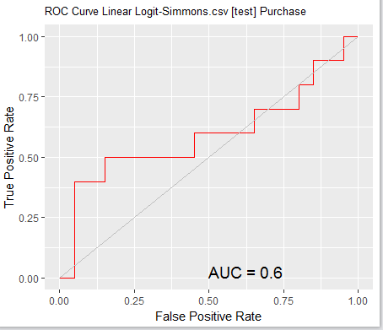
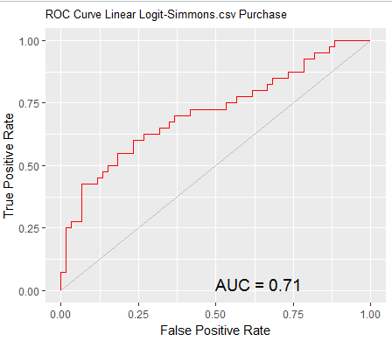
Plots for ROC
Test data
Full Data

Slide 30
Appendix
Please find the word document uploaded along with this PPT for R code on the same Problem statement using Logistic regression model.

Slide 31
Thank you!!! ☺

